Slide 1
Gridworld with Q-learning
Andrea Mazzolini, Como 2019
https://tinyurl.com/y54fvebl

Slide 2
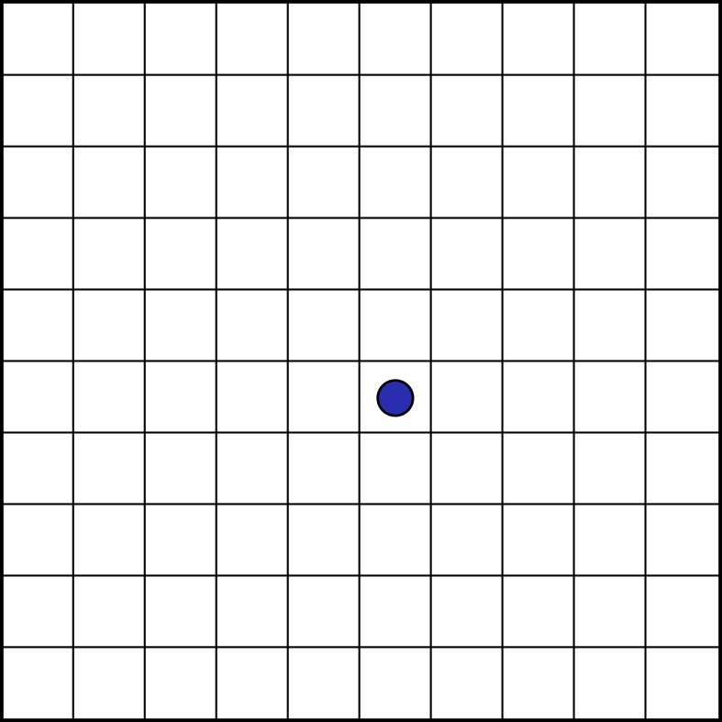

Gridworld
$d×d$2-dimensional lattice.

Slide 3
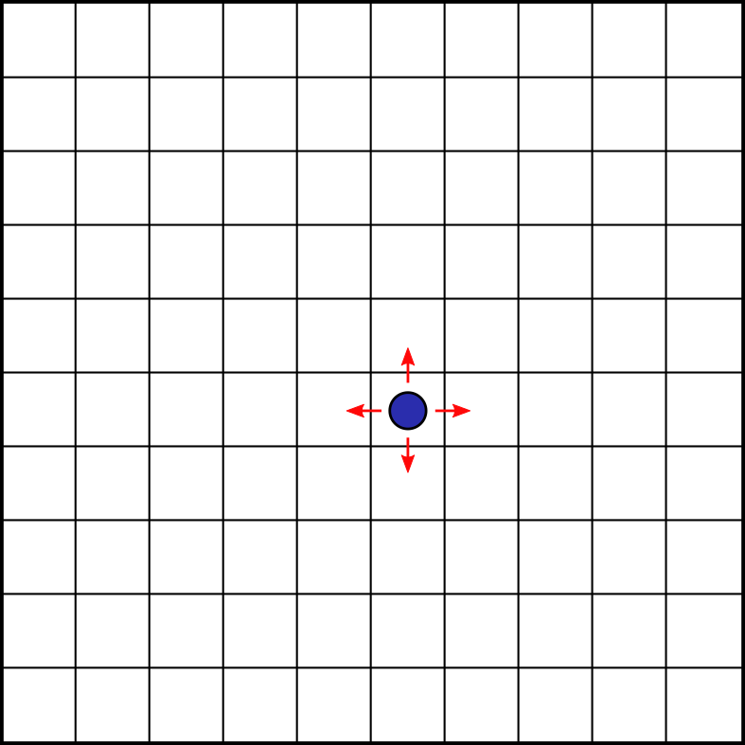
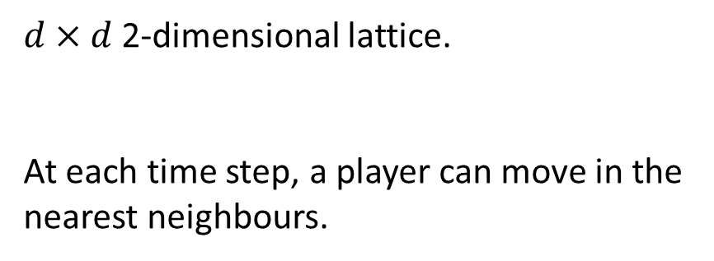
Gridworld
$d×d$2-dimensional lattice.
At each time step, a player can move in the nearest neighbours.

Slide 4
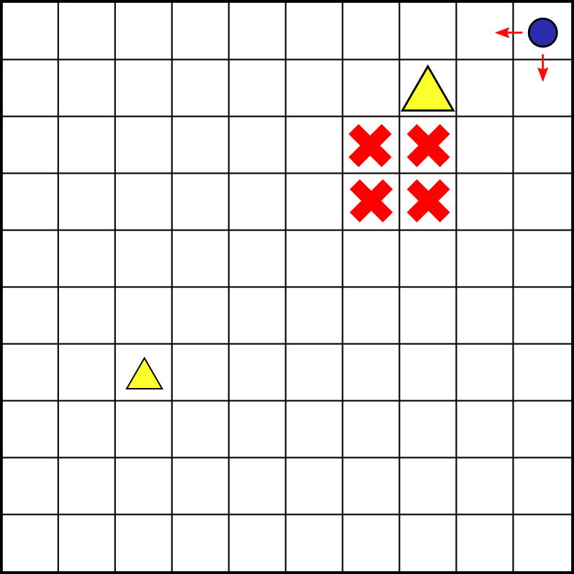
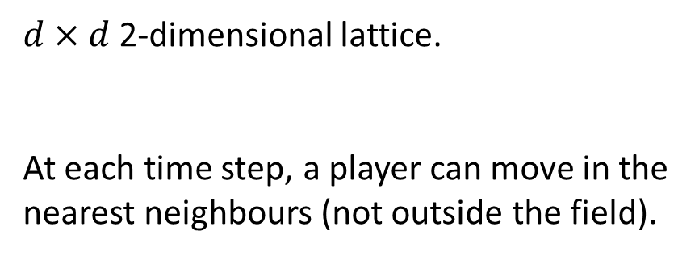
Gridworld
$d×d$2-dimensional lattice.
At each time step, a player can move in the nearest neighbours (not outside the field).

Slide 5
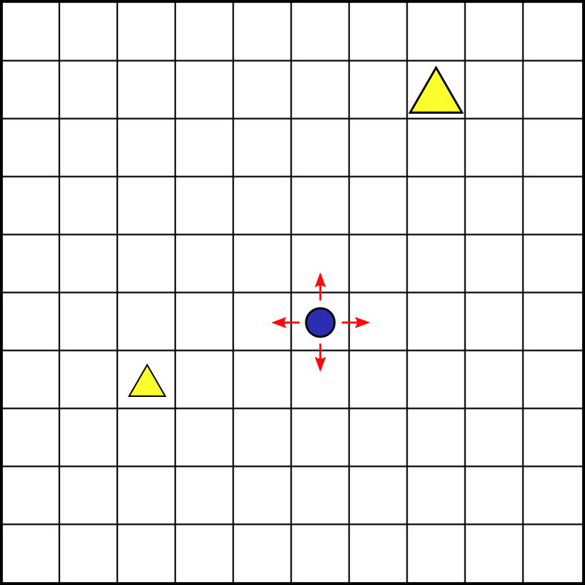
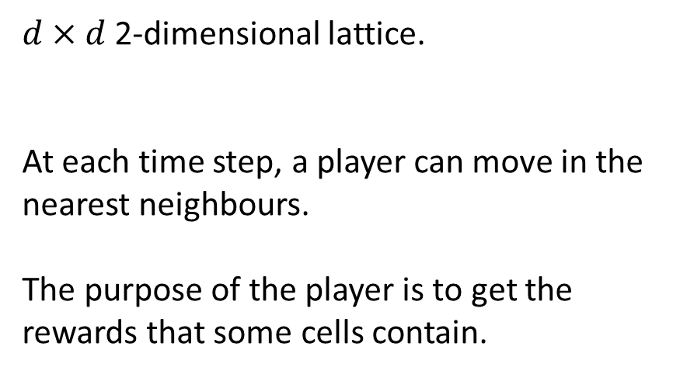
Gridworld
$d×d$2-dimensional lattice.
At each time step, a player can move in the nearest neighbours.
The purpose of the player is to get the rewards that some cells contain.

Slide 6
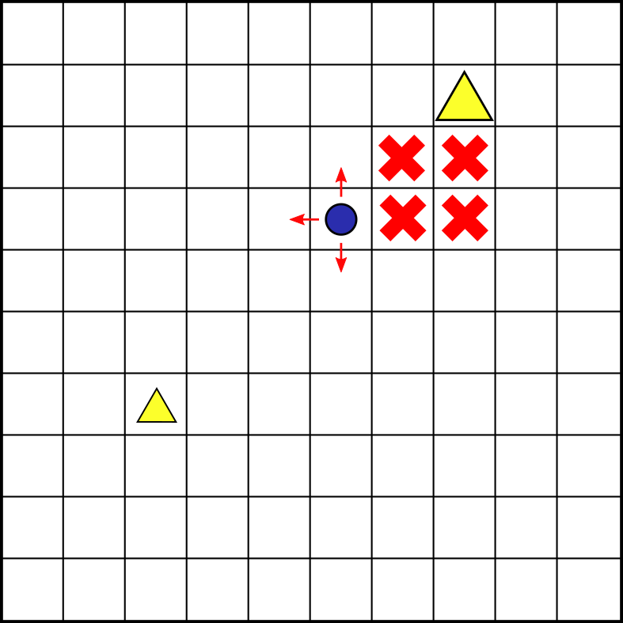
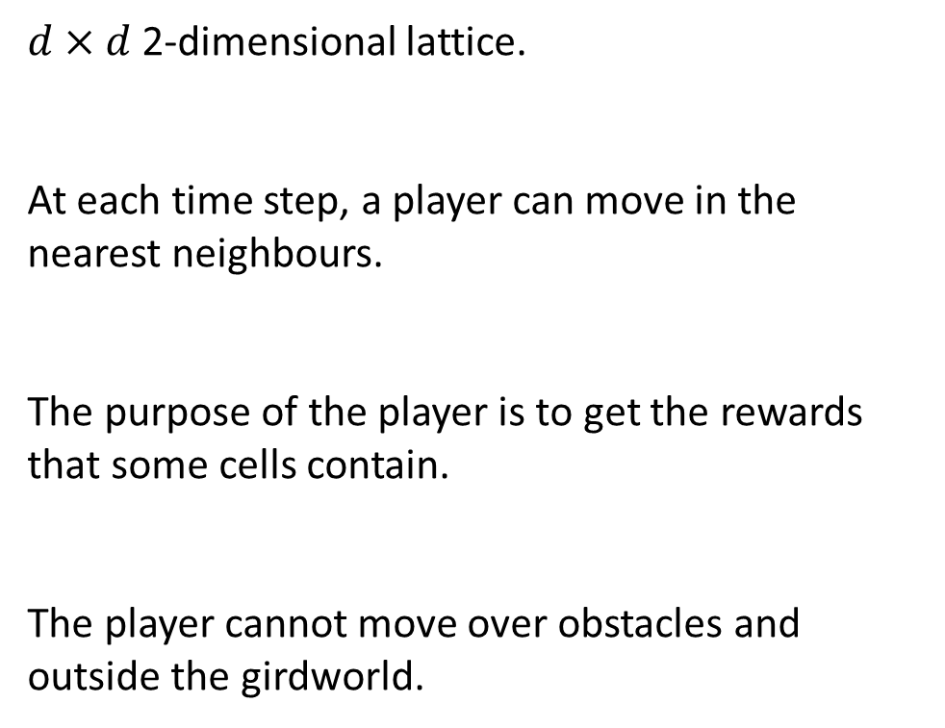
Gridworld
$d×d$2-dimensional lattice.
At each time step, a player can move in the nearest neighbours.
The purpose of the player is to get the rewards that some cells contain.
The player cannot move over obstacles and outside the girdworld.

Slide 7

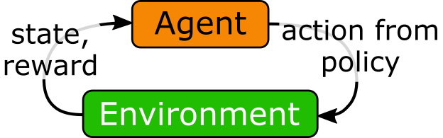

Gridworld as a MDP
x
The states are the world coordinates:
$$s=\left(x,y\right)$$
y

Slide 8
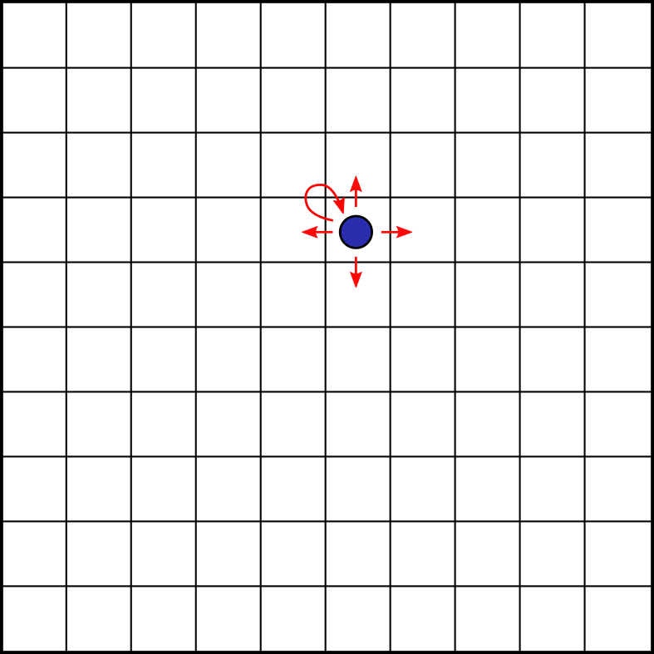
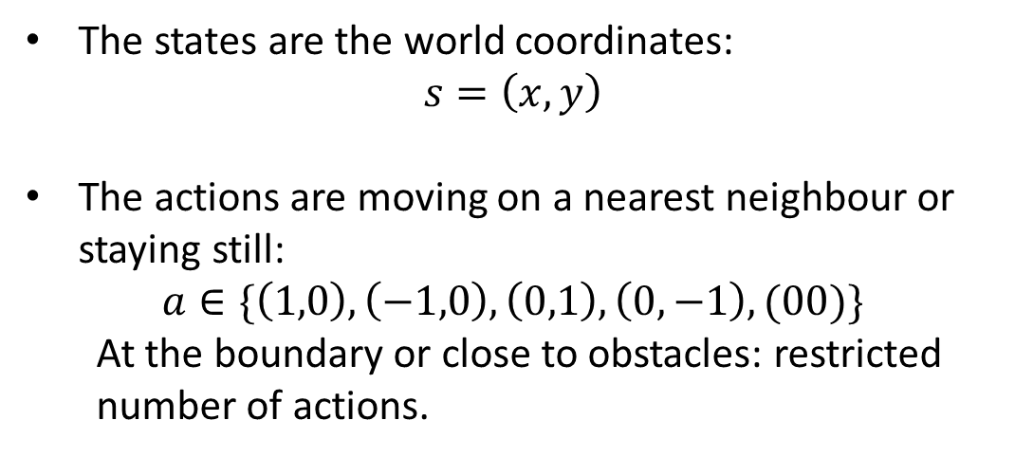
Gridworld as a MDP
The states are the world coordinates:
$$s=\left(x,y\right)$$
The actions are moving on a nearest neighbour or staying still:
$$a∈\{\left(1,0\right),\left(−1,0\right),\left(0,1\right),\left(0,−1\right),(00)\}$$
At the boundary or close to obstacles: restricted number of actions.

Slide 9
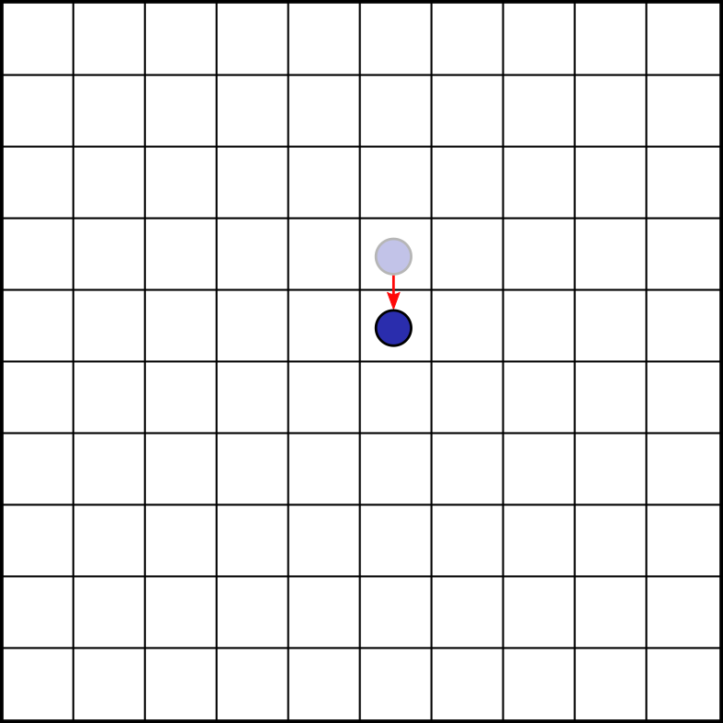
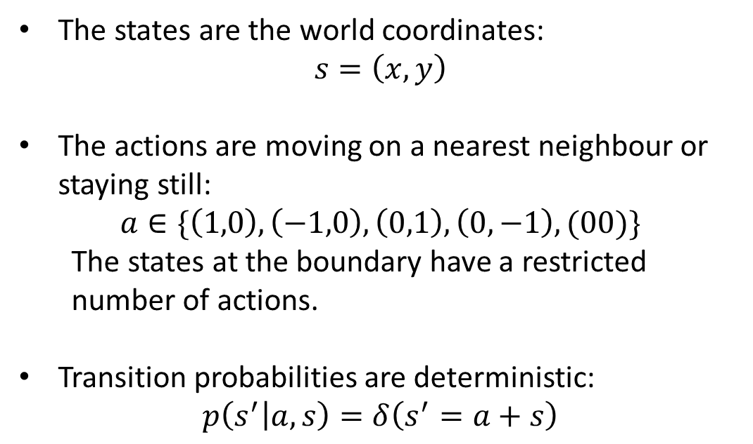
Gridworld as a MDP
The states are the world coordinates:
$$s=\left(x,y\right)$$
The actions are moving on a nearest neighbour or staying still:
$$a∈\{\left(1,0\right),\left(−1,0\right),\left(0,1\right),\left(0,−1\right),(00)\}$$
The states at the boundary have a restricted number of actions.
Transition probabilities are deterministic:
$$p\left(s^{′} | a,s\right)=δ\left(s^{′}=a+s\right)$$

Slide 10
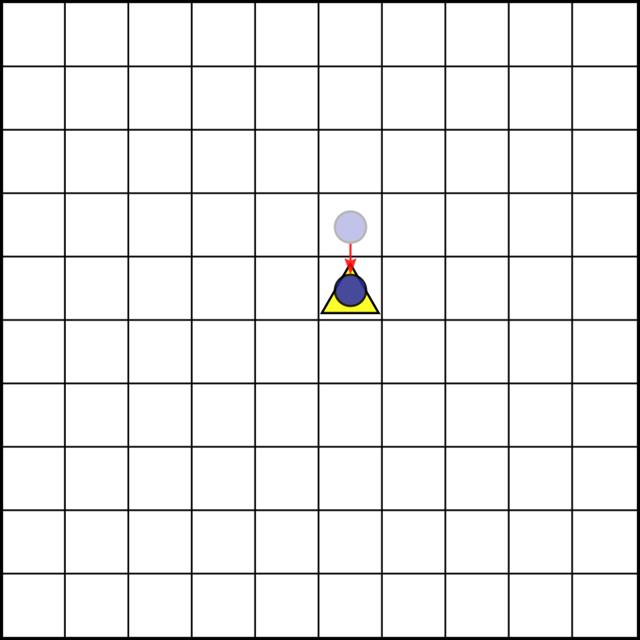
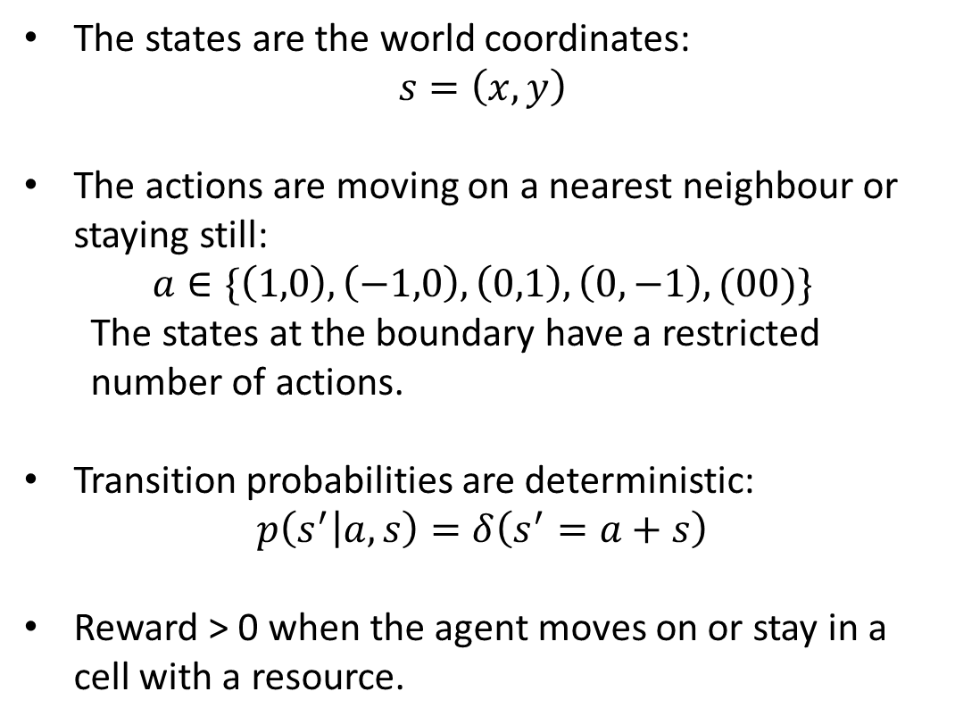
Gridworld as a MDP
The states are the world coordinates:
$$s=\left(x,y\right)$$
The actions are moving on a nearest neighbour or staying still:
$$a∈\{\left(1,0\right),\left(−1,0\right),\left(0,1\right),\left(0,−1\right),(00)\}$$
The states at the boundary have a restricted number of actions.
Transition probabilities are deterministic:
$$p\left(s^{′} | a,s\right)=δ\left(s^{′}=a+s\right)$$
Reward > 0 when the agent moves on or stay in a cell with a resource.

Slide 11
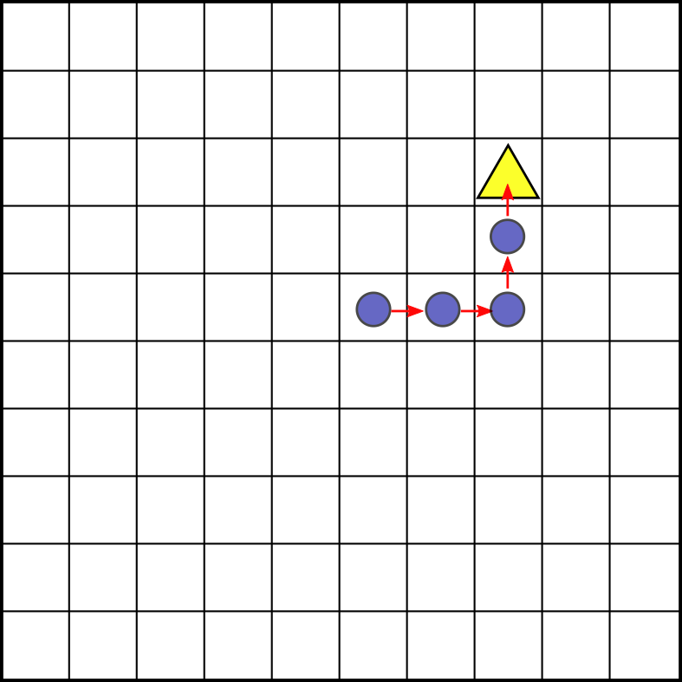
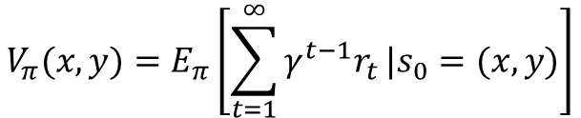
Gridworld as a MDP
Utility function:
$$V_{π}(x,y)=E_{π}\left[\sum_{t=1}^{∞}{γ^{t−1}r_{t}}|s_{0}=(x,y)\right]$$
Policy: which action to take
Reward
Discount factor
$$V_{\left(→,→,↑,↑\right)}\left(x=5,y=5\right)=0+γ∗0+γ^{2}∗0+γ^{3}∗$$

Slide 12
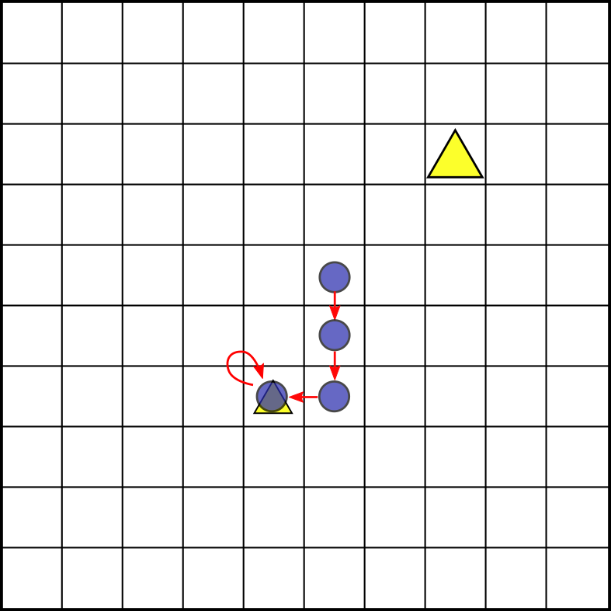
Gridworld as a MDP
Utility function:
$$V_{π}(x,y)=E_{π}\left[\sum_{t=1}^{∞}{γ^{t−1}r_{t}}|s_{0}=(x,y)\right]$$
Policy: which action to take
Reward
Discount factor
$$V_{\left(→,→,↑,↑\right)}\left(x=5,y=5\right)=0+γ∙0+γ^{2}∙0+γ^{3}∙$$
$$V_{\left(↓,↓,←,∙\right)}\left(x=5,y=5\right)=0+γ∙0+γ^{2}∙ +γ^{3}∙$$

Slide 13
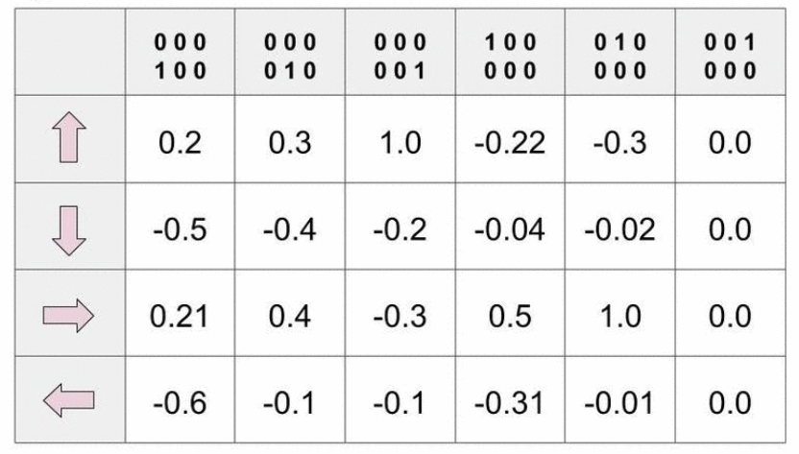
Q-learning
Q-learning is a model-free reinforcement-learning algorithm for any finite Markov decision processes.
Each state-action pair has a quality associated, Q(s,a).
States (gridworld position)
Actions

Slide 14
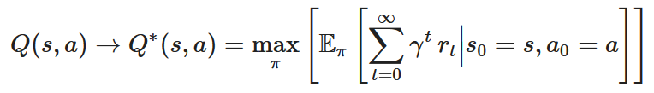

Q-learning
Q-learning is a model-free reinforcement-learning algorithm for any finite Markov decision processes.
Each state-action pair has a quality associated, Q(s,a).
States (gridworld position)
At convergence the quality is the best return from a given state taking a given action:
Actions

Slide 15

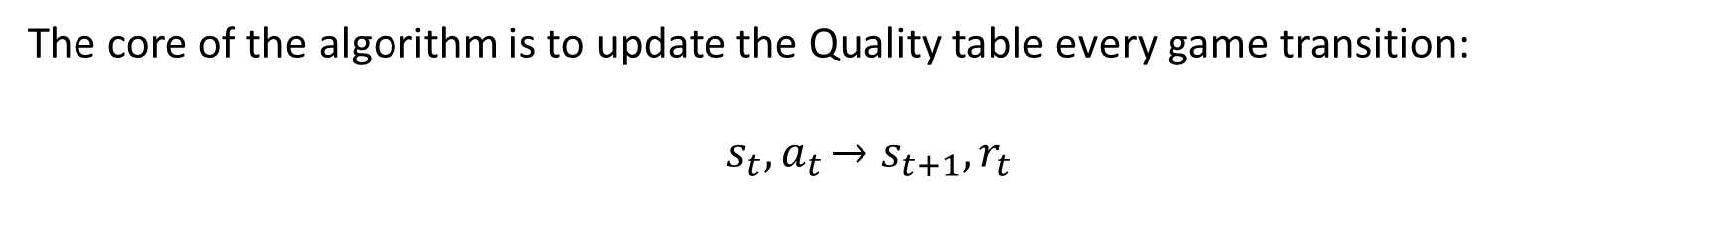
Q-learning
The core of the algorithm is to update the Quality table every game transition:
$$s_{t}{,a}_{t}→s_{t+1},r_{t}$$
Temporal-difference error
Learning rate
Discount factor

Slide 16

Q-learning
The core of the algorithm is to update the Quality table every game transition:
$$s_{t}{,a}_{t}→s_{t+1},r_{t}$$
Temporal-difference error
Learning rate
Discount factor
Deviation from the Bellman equation in one sample:

Slide 17

Epsilon-greedy Q-learning
How to choose an action a_{t} given a state s_{t} for the transition:
$$s_{t}{, a}_{t}→s_{t+1}, r_{t} ?$$
Exploration move: choose at random.
Exploitation move: choose the action that maximizes the current quality funtion.
Epsilon greedy rule: choose exploration with probability epsilon, choose exploitation otherwise.

Slide 18
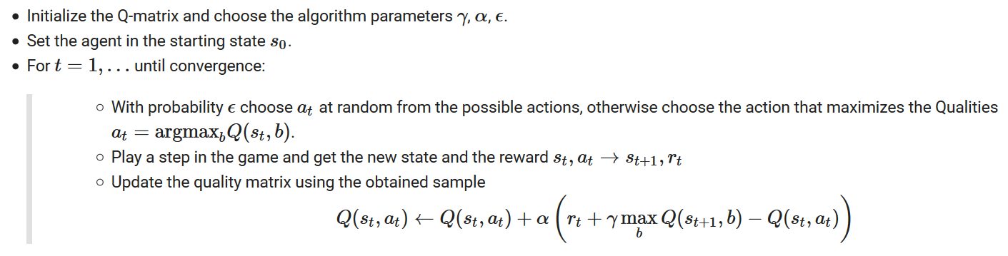
Pseudocode, first version

Slide 19
Pseudocode, second version
Two tricks to improve the performance:
Episodic training: After T steps the game restarts from s₀. Each one of these runs is called an episode.
Epsilon scheduling: I need more exploration at the beginning to have a general idea of the qualities, and less at the end, in order to improve the estimates around the «best» trajectory. Epsilon decreases with time.

Slide 20
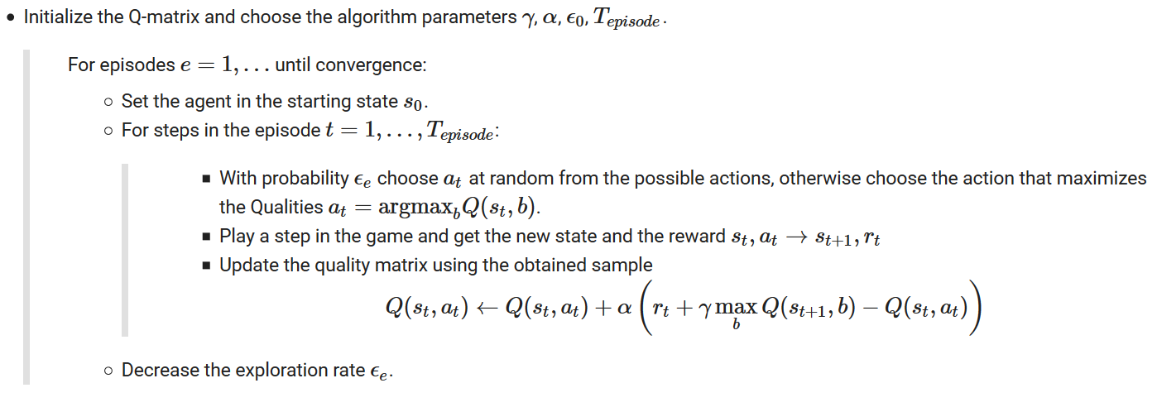
Pseudocode, second version

